Slide 1
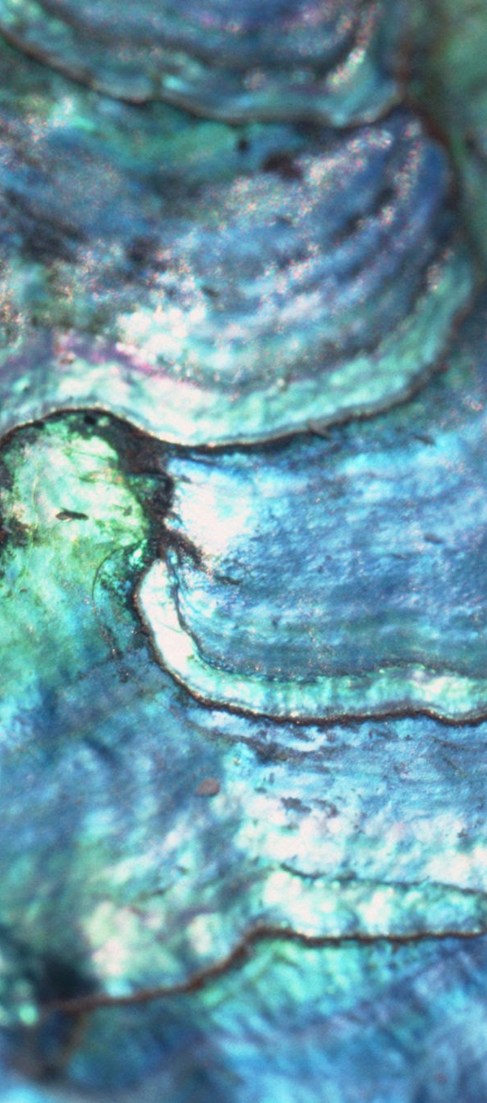
Project 2: Abalone Age Presentation
Aayush Dalal & Jacqueline Vu
DS6306: Doing Data Science
December 13th, 2025
Notes:
7 minutes maximum to present this

Slide 2
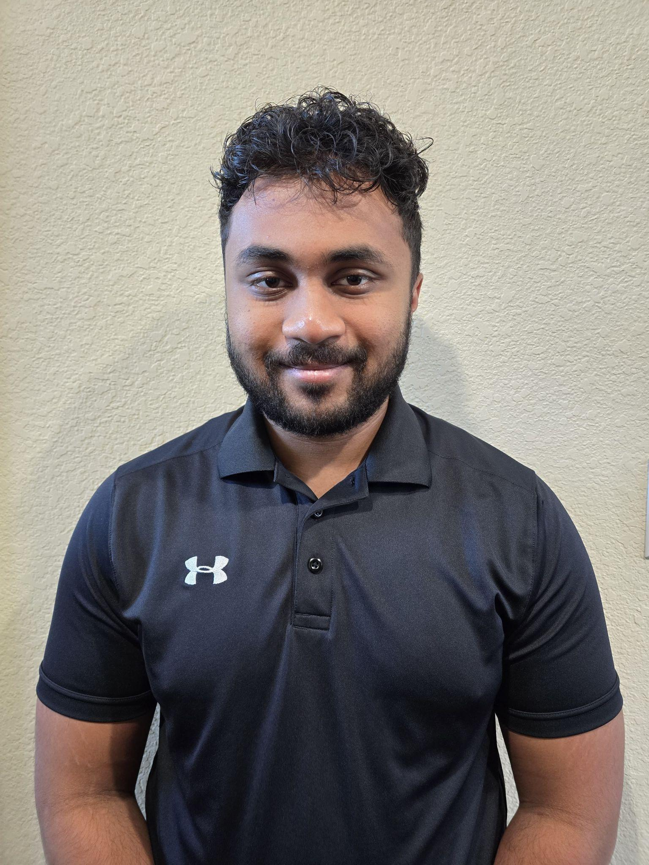

Meet the Team
Aayush Dalal
Jacqueline Vu
Model development, feature engineering, Shiny app development
Exploratory Analysis, interpretation, visualization, RAG Development
DS6306: Doing Data Science

Slide 3
Contents
Project Introduction
Objective C: RAG Implementation
Objective A: Age Prediction
Conclusion
Objective B: Data Insights & RShiny Application
Project Artifacts
01
04
02
05
03
06
DS6306: Doing Data Science

Slide 4
01. Project Introduction
DS6306: Doing Data Science

Slide 5
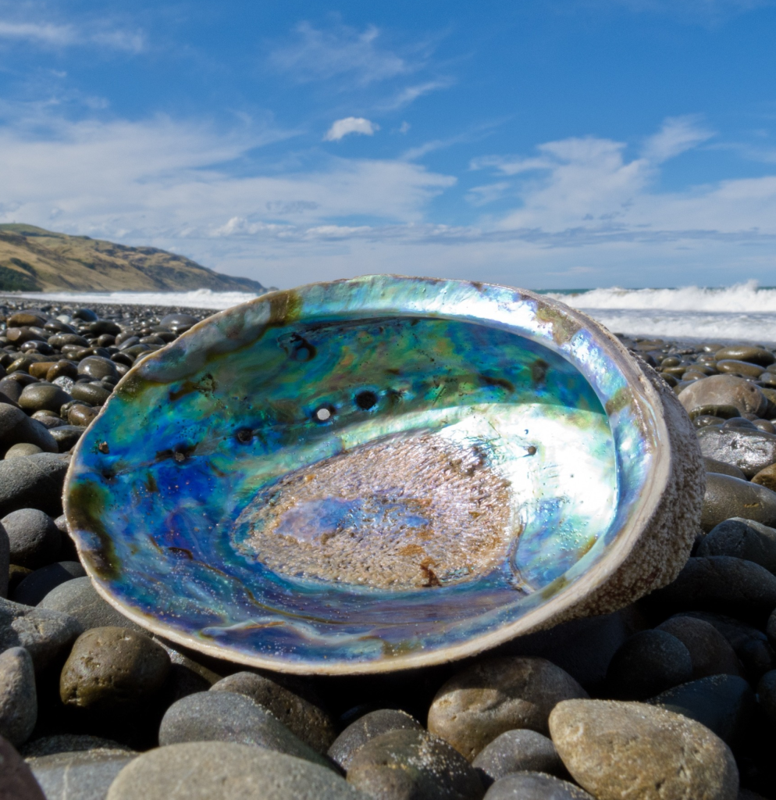
Project Motivation
Abalone age is critical for fisheries management and ecological research.
Traditional age estimation is destructive and costly.
Therefore, our goal is to predict age from physical measurements and understand growth drivers.
DS6306: Doing Data Science

Slide 6
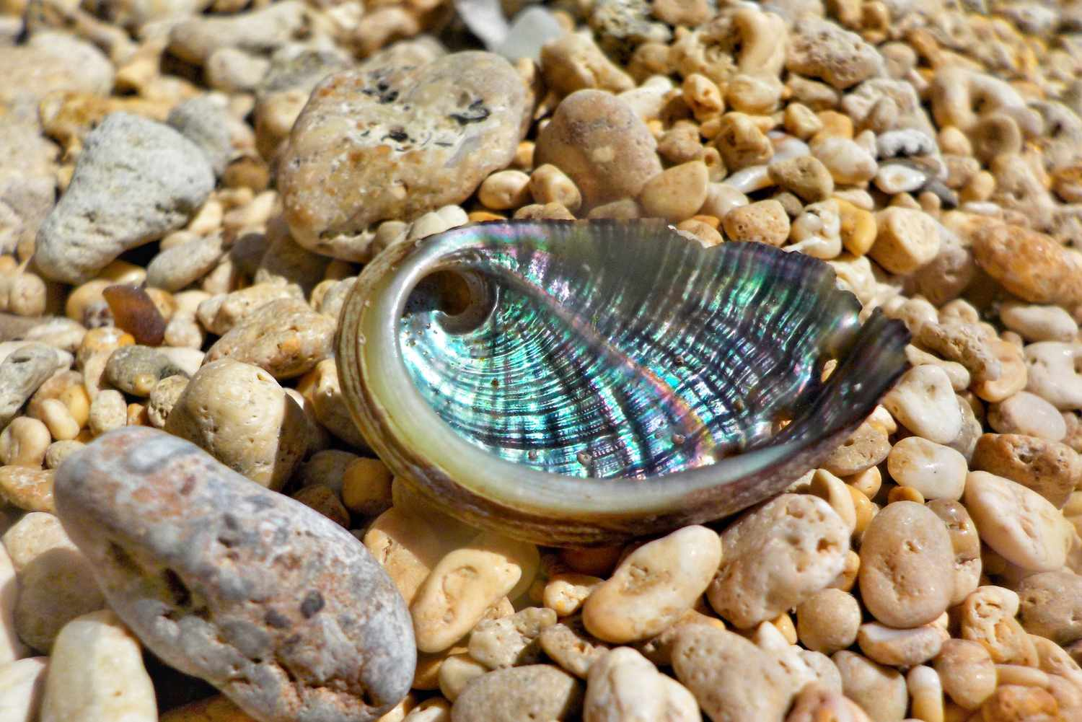
Project Overview
Objective A: Predict abalone age using regression-based models
Objective B: Identify key biological drivers of age
Deliverables:
Predictive Models
Insights & visualizations
Shiny app
RAG Implementation
Written report
DS6306: Doing Data Science

Slide 7
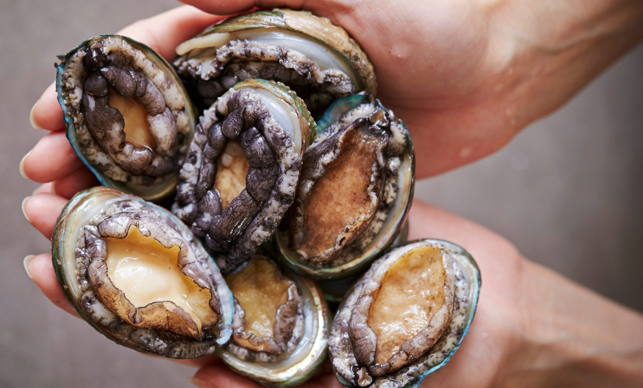
Evaluation Criteria
Prediction accuracy measured by MAE
Model interpretability
Biological plausibility of insights
Reproducibility and presentation quality
DS6306: Doing Data Science

Slide 8

Project Workflow
Data cleaning & EDA
Baseline linear regression
Feature engineering & regularization
Spline-stepwise modeling
Insight mining (Objective B)
Shiny app & reporting
RAG application
DS6306: Doing Data Science

Slide 9
02. Objective A: Age Prediction
DS6306: Doing Data Science

Slide 10
Modeling Approach
Linear regression baseline
Elastic Net for regularization
Spline-stepwise hybrid model
DS6306: Doing Data Science

Slide 11

Modeling Challenges
Strong multicollinearity among size variables
Nonlinear growth patterns
Trade-off between accuracy and interpretability
DS6306: Doing Data Science

Slide 12
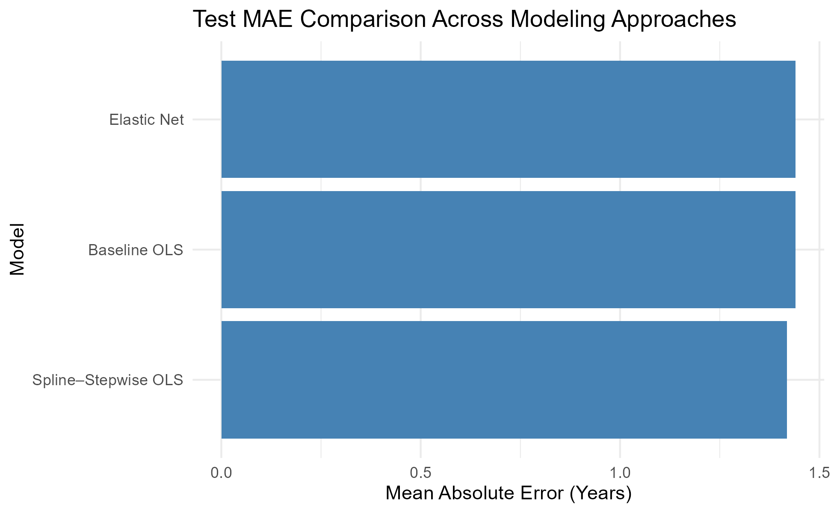
Key Results: Model Performance
~1.44
~1.44
~1.42
DS6306: Doing Data Science

Slide 13
03. Objective B: Data Insights &
RShiny Application
DS6306: Doing Data Science

Slide 14
Data Insights
Shell weight turns out to be the strongest predictor of age.
Height and diameter reflect growth maturity.
Older abalones invest more in shell than meat.
Growth slows at larger sizes (nonlinear effects).
DS6306: Doing Data Science

Slide 15
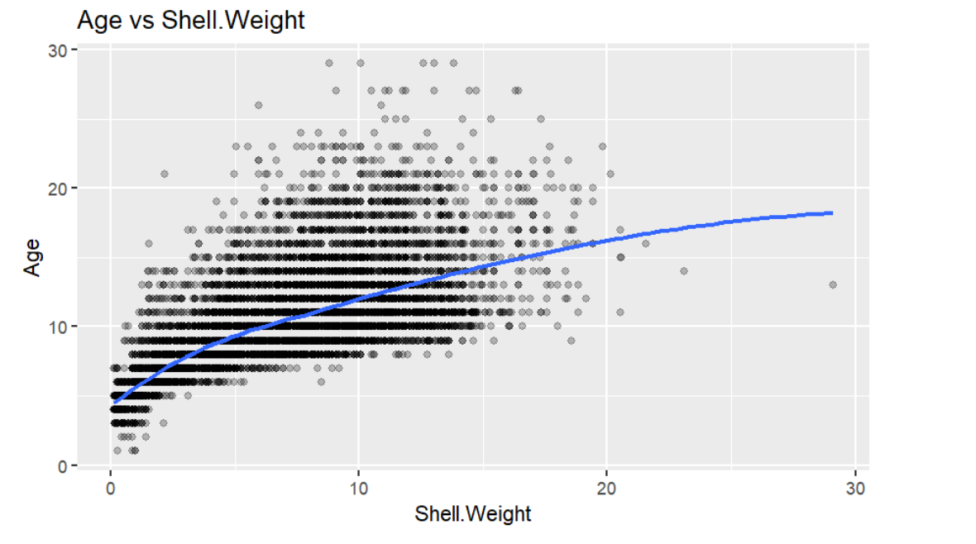
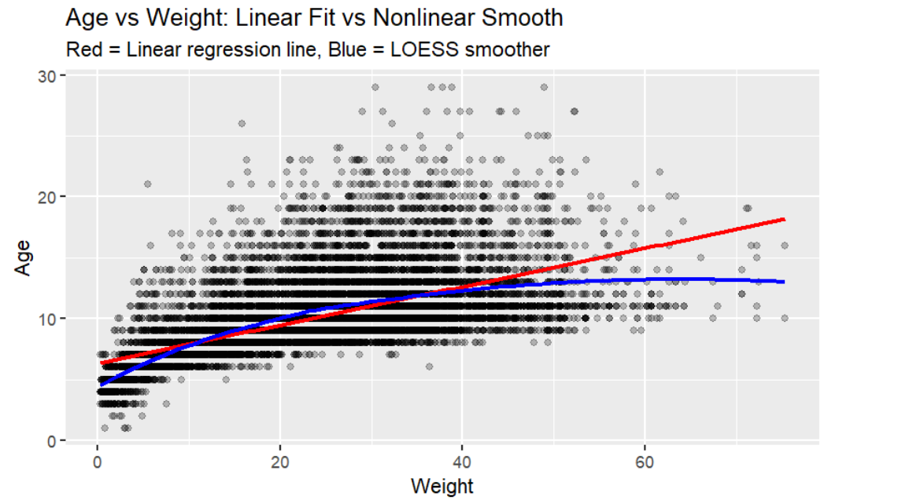
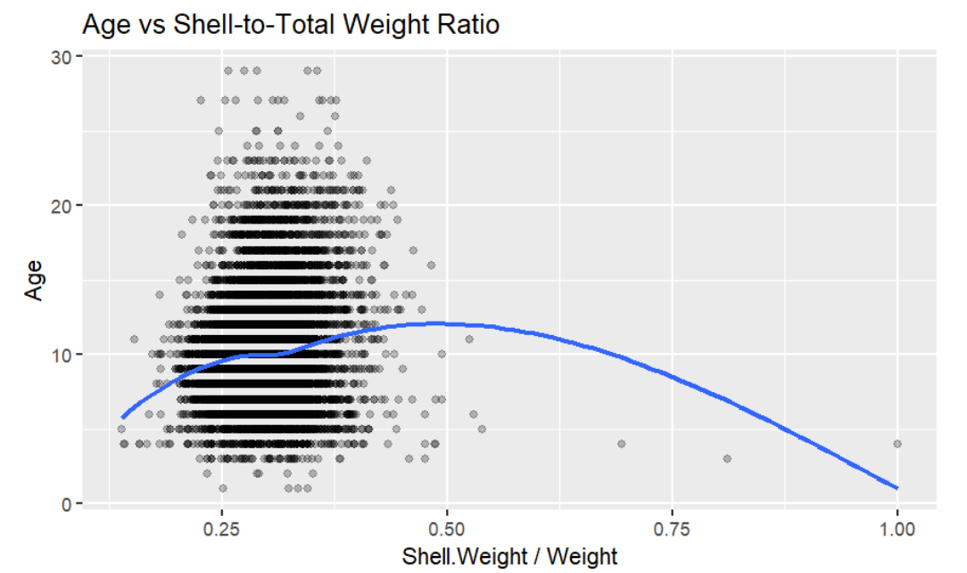
Visual Evidence
DS6306: Doing Data Science

Slide 16
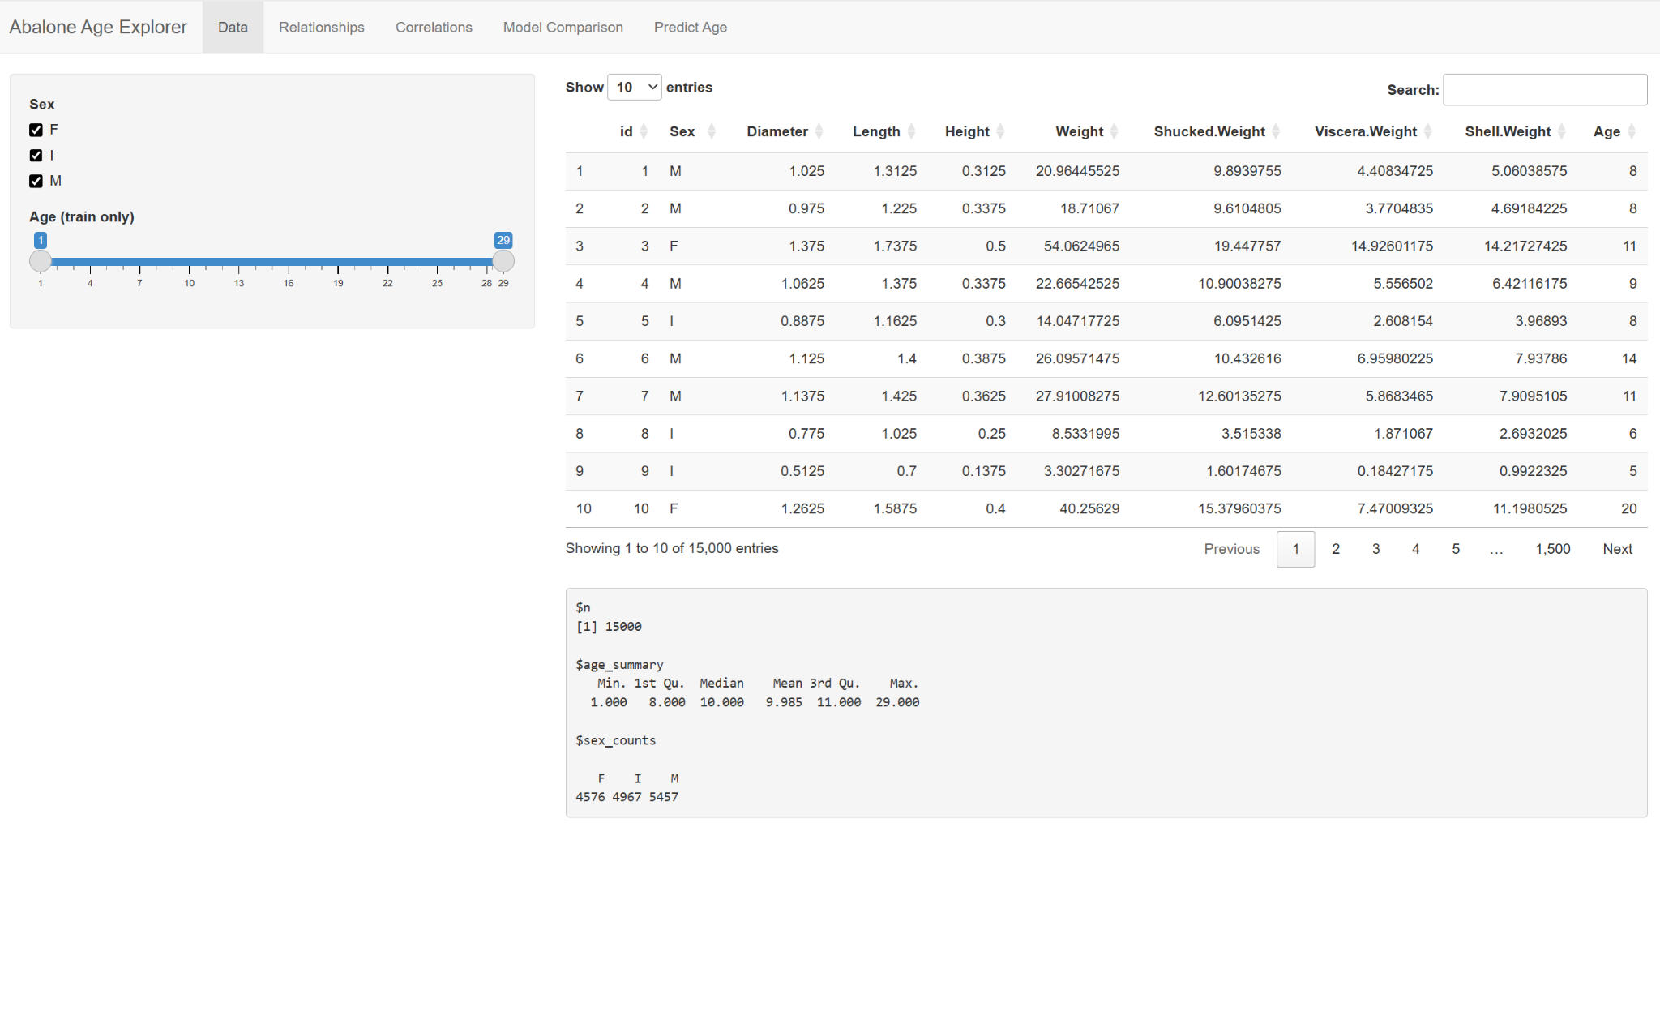
RShiny Application
Interactive exploration of predictors vs age
Compare model predictions
Supports interpretability
DS6306: Doing Data Science

Slide 17
04. Objective C: RAG Implementation
DS6306: Doing Data Science

Slide 18
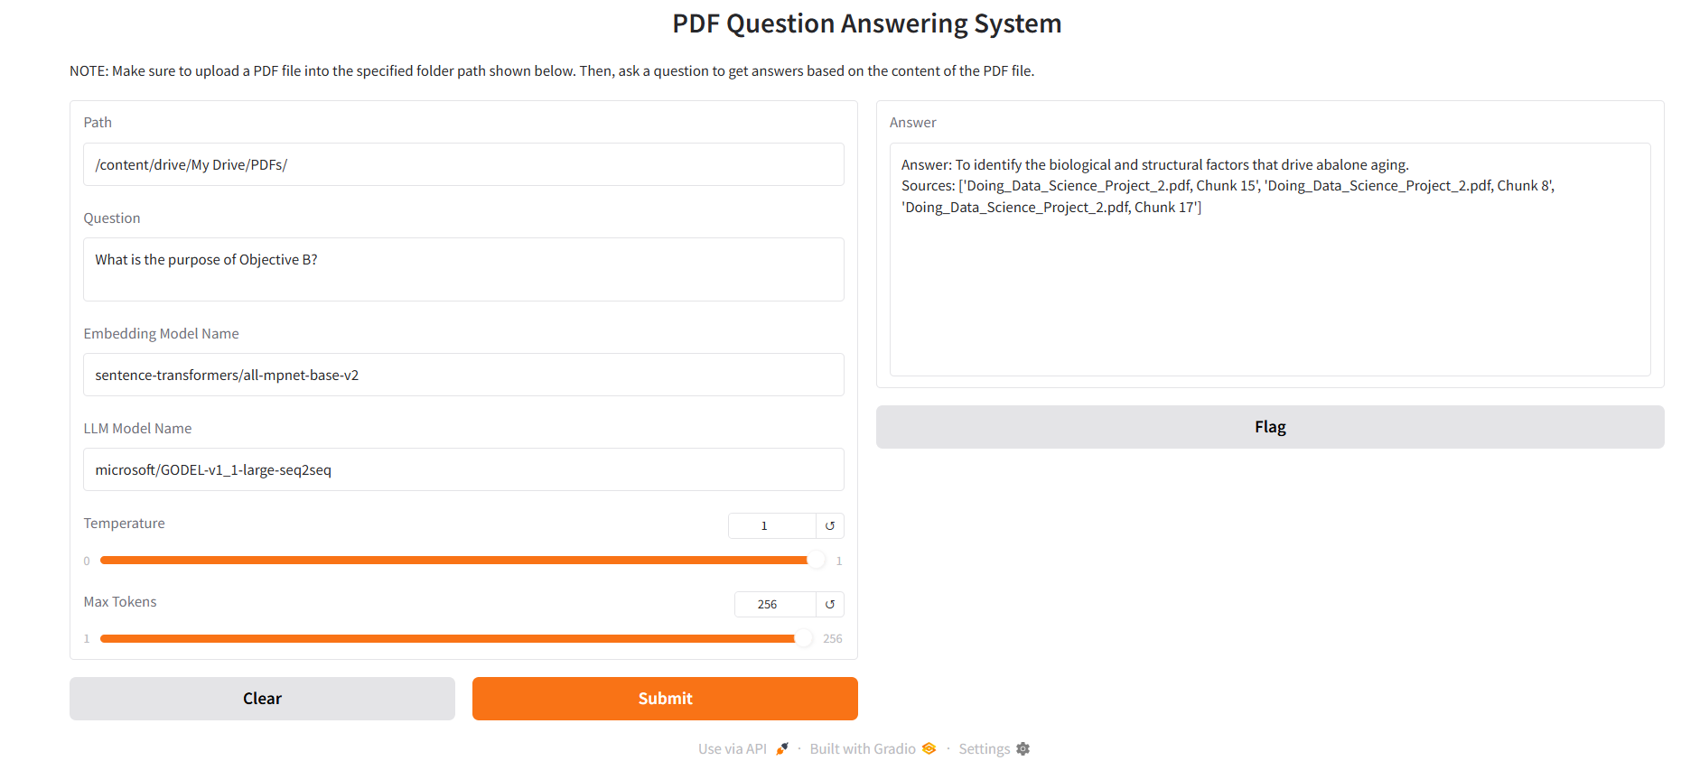
RAG Implementation in Gradio
This is the path to retrieve the PDF file that will be analyzed.
DS6306: Doing Data Science

Slide 19
RAG Implementation in Gradio
This is the path to retrieve the PDF file that will be analyzed.
The user will type out their question here.
DS6306: Doing Data Science

Slide 20
RAG Implementation in Gradio
This is the path to retrieve the PDF file that will be analyzed.
The user will type out their question here.
This embedding model helps increase the accuracy in the response.
DS6306: Doing Data Science

Slide 21
RAG Implementation in Gradio
This is the path to retrieve the PDF file that will be analyzed.
The user will type out their question here.
This embedding model helps increase the accuracy in the response.
This LLM model retrieves the user’s questions and the chunks of the PDF file to synthesize a coherent answer in the answer box.
DS6306: Doing Data Science

Slide 22
RAG Implementation in Gradio
This is the path to retrieve the PDF file that will be analyzed.
The user will type out their question here.
This embedding model helps increase the accuracy in the response.
This LLM model retrieves the user’s questions and the chunks of the PDF file to synthesize a coherent answer in the answer box.
The higher the temperature, the more creative and varied the answer will be. The lower the temperature, the more concise and factual the answer will be.
DS6306: Doing Data Science

Slide 23
RAG Implementation in Gradio
This is the path to retrieve the PDF file that will be analyzed.
The user will type out their question here.
This embedding model helps increase the accuracy in the response.
This LLM model retrieves the user’s questions and the chunks of the PDF file to synthesize a coherent answer in the answer box.
The higher the temperature, the more creative and varied the answer will be. The lower the temperature, the more concise and factual the answer will be.
Max tokens determine the length of the answer.
DS6306: Doing Data Science

Slide 24
RAG Implementation in Gradio
This is the path to retrieve the PDF file that will be analyzed.
The user will type out their question here.
This embedding model helps increase the accuracy in the response.
The user’s answer will be displayed here.
This LLM model retrieves the user’s questions and the chunks of the PDF file to synthesize a coherent answer in the answer box.
The higher the temperature, the more creative and varied the answer will be. The lower the temperature, the more concise and factual the answer will be.
Max tokens determine the length of the answer.
DS6306: Doing Data Science

Slide 25
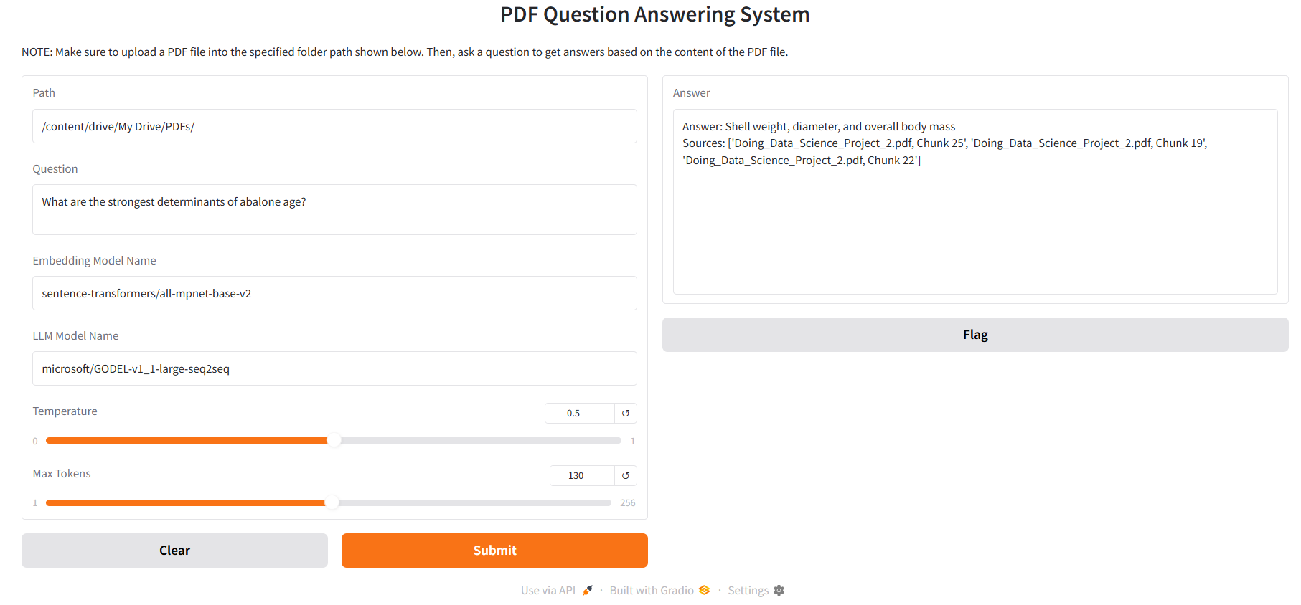
RAG Implementation in Gradio
DS6306: Doing Data Science

Slide 26
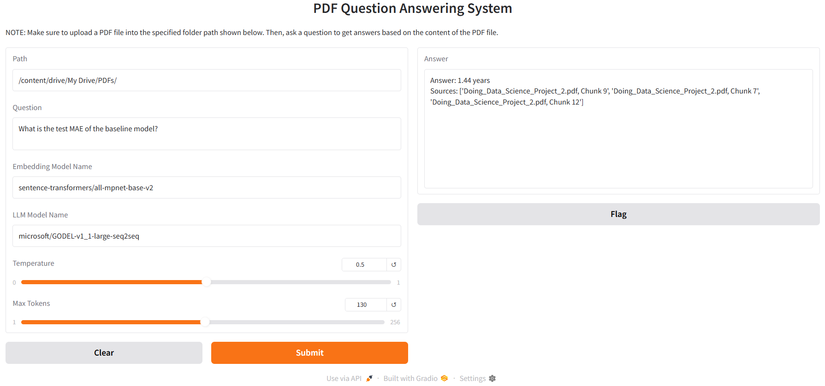
RAG Implementation in Gradio
DS6306: Doing Data Science

Slide 27
05. Conclusion
DS6306: Doing Data Science

Slide 28
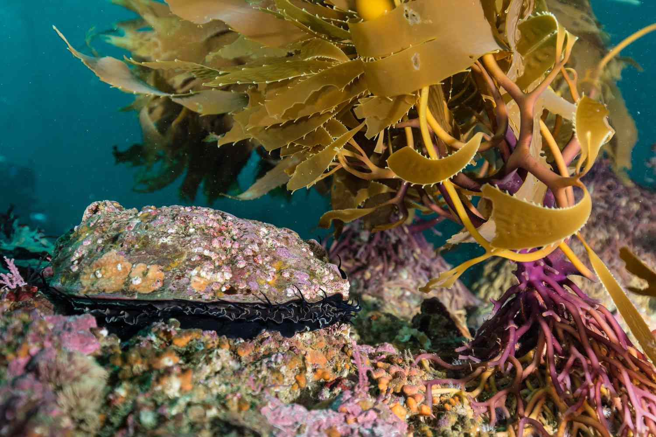
Conclusion
Linear regression remains powerful with proper feature engineering.
Biological insights align with predictive findings.
Approach generalizes to other ecological datasets.
DS6306: Doing Data Science

Slide 29
06. Project Artifacts
DS6306: Doing Data Science

Slide 30
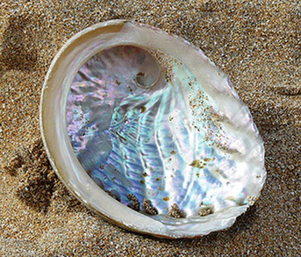
Project Artifacts
The code, PDF report, plots, RShiny App, and RAG Application are located in https://github.com/aad6383/AbaloneProject.
DS6306: Doing Data Science

Slide 31

Any questions?
Ask away!
Let's discuss any doubts or concerns.
If something comes up later, contact adalal@smu.edu or jqvu@mail.smu.edu.
Company Name

